Slide 1
Stata (Level 1 – Data) Workshop
Text
Text
Quantitative and Computing Lab (QCL)
Text
Text

Slide 2
Before We Begin
Sign-in Link
Retrieve Workshop file at (https://github.com/sam9807/STATA-L1-Workshop.git)
After you have downloaded “Workshop_Files” compressed file, extract the folder on “Desktop”
Learning Objective: Ensure that all participants gain some level of confidence using Stata and statistical analysis
Tip: Open .do, PDF, and any other files that I am using throughout the workshop to make sure that you are following along.

Slide 3
Workshop Agenda
1
User Interface: Console
03:00 PM – 03:05 PM
User Interface: Console
2
Data Import
Data Import
03:05 PM – 03:10 PM
3
Define Data
Define Data
03:10 PM – 03:25 PM
4
Summary Statistics
Summary Statistics
03:25 PM – 03:50 PM
5
Regression Analysis
03:50 PM – 04:15 PM
6
Charts: Histogram and Scatter Plot
04:15 PM – 04:20 PM
7
Hands-on Exercises
04:20 PM – 04:50 PM
8
Q&A
04:50 PM – 04:00 PM

Slide 4
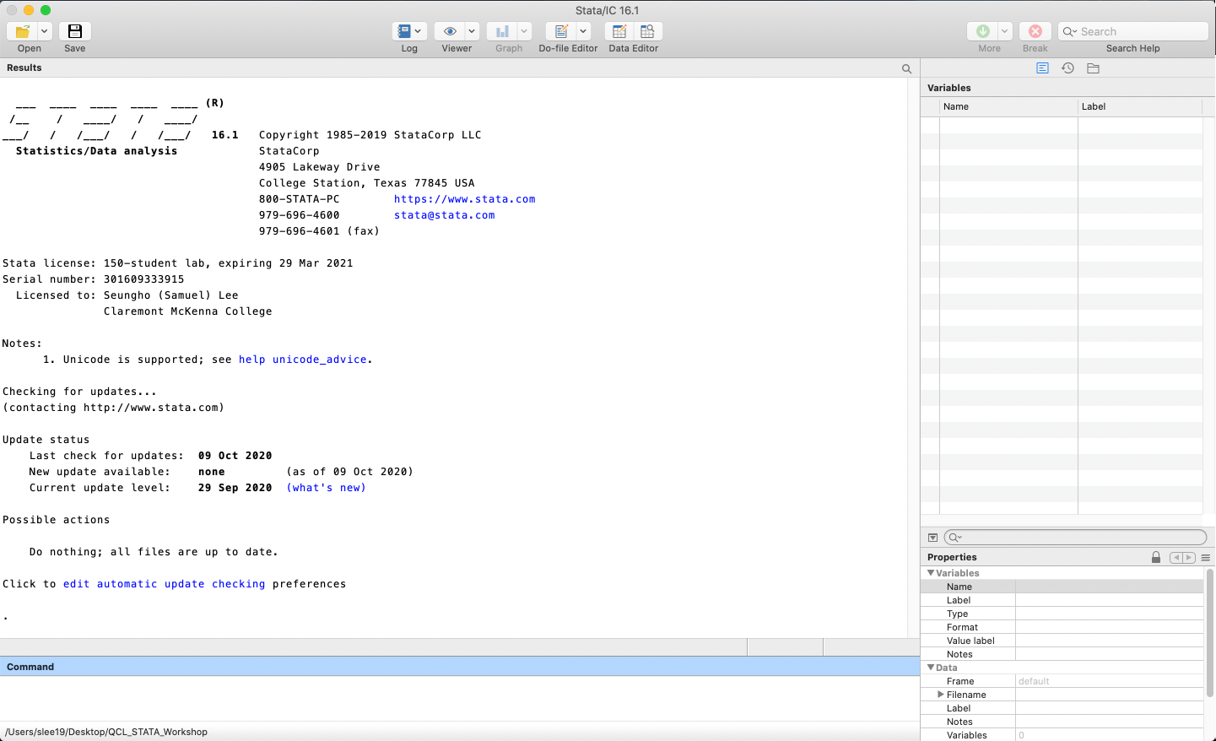
Stata Console – Main Window
1
8
9
10
11
12
13
14
15
16
17
18
19
20
21
22
23
24
25
26
2
3
4
5
6
7
Stata window largely consists of command history, command line, output window, variable list, and data format.
1
Results: displays commands and resulting outputs from current session
1
3
4
2
Command Line: a window where a user enters a command
3
Variable List: lists all variables specified in active session
4
Command History: shows every command performed in active session
5
5
Data Format: detailed description of highlighted variable (e.g., type)
2

Slide 5
Stata Console – How It Works
1
8
9
10
11
12
13
14
15
16
17
18
19
20
21
22
23
24
25
26
2
3
4
5
6
7
While Stata is truly “interactive,” users can also run a program as a “batch” mode (running commands listed on a file)
Interactive Use: typing Stata commands directly on the Command window to produce results.
Batch Mode: All commands are compiled in a file (called Do-Files), which Stata reads and executes.
During this workshop, we are going to use Do-File “.do” to import and explore data and conduct relevant analysis

Slide 6
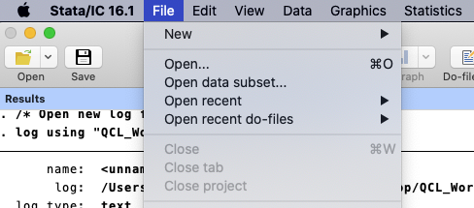
Stata Console – Do-Files (Open)
1
8
9
10
11
12
13
14
15
16
17
18
19
20
21
22
23
24
25
26
2
3
4
5
6
7
Press “File” on a top menu bar
Select “Open…”
Go to “Workshop_Files” folder we downloaded on “Desktop” folder
Open “Stata_Workshop_QCL.do” file

Slide 7
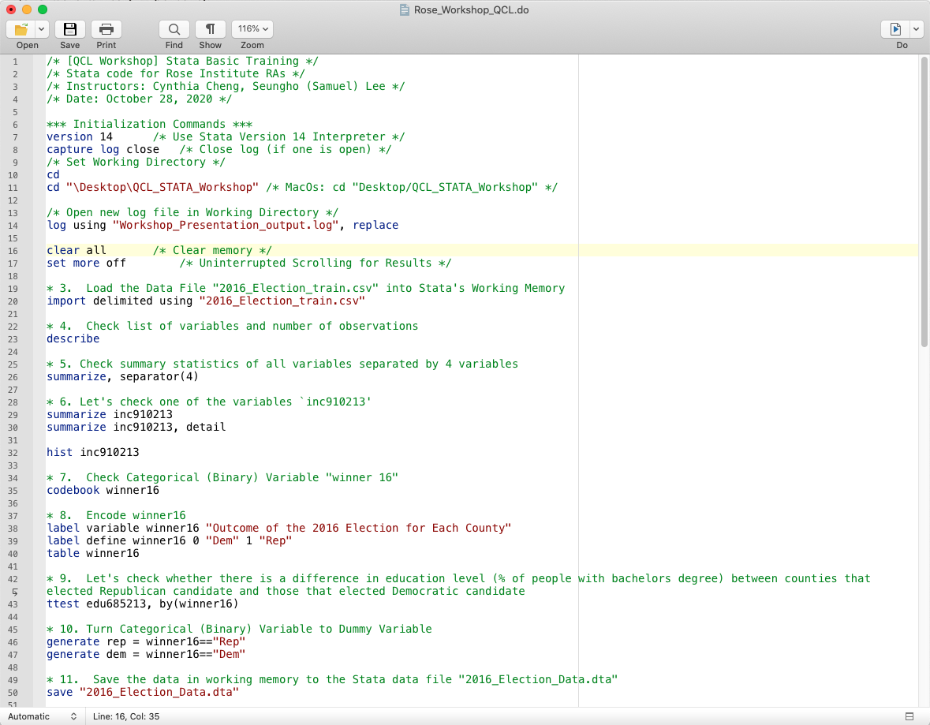
Stata Console – Do-Files
1
8
9
10
11
12
13
14
15
16
17
18
19
20
21
22
23
24
25
26
2
3
4
5
6
7
Think of it as a set of instructions for Stata to conduct without manual input
It is a good practice to compile Do-File since doing so allows others to reproduce
Comment:
/* [INSERT COMMENT] */: comments a specified section
*: comments a whole line
Press boxed icon shown on the screenshot to execute the file

Slide 8
Data Import
1
8
9
10
11
12
13
14
15
16
17
18
19
20
21
22
23
24
25
26
2
3
4
5
6
7
Setting Working Directory:
“cd” command sets which folder you are going to be working on
Make sure to include data files in the folder
Importing Data
Run import delimited using “filename.csv” command to import data files
You can also import Excel files (and many others) as well as direct URL link!
Notes:
Reg, scatter, corr., skewness (10-15 min last → go through hands-on q’s)

Slide 9
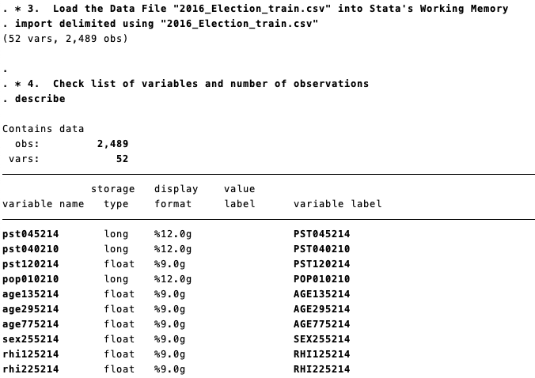
Define data
1
8
9
10
11
12
13
14
15
16
17
18
19
20
21
22
23
24
25
26
2
3
4
5
6
7
Whenever you use import function, it outputs a message that indicates the numbers of variables and observations in the dataset. For more details, use describe
Data: Sampled 2016 Presidential Election Data by Counties
describe function can be used see a more detailed information of the imported data:
Observations, Variables
Variable Name, Storage Type (e.g., long, float), Display format, value label, variable label
On Stata, you can label values and variables, which are helpful references (we will look at these functions during the Hands-on Exercise)

Slide 10
Define data
1
8
9
10
11
12
13
14
15
16
17
18
19
20
21
22
23
24
25
26
2
3
4
5
6
7
Whenever you use import function, it outputs a message that indicates the numbers of variables and observations in the dataset. For more details, use describe
Common Storage Types
byte: integer values between -127 and 100
int: integer values between -32,767 and 32,740
long: integer values between -2,147,483,647 and 2,147,483,620
float: real numbers (i.e., numbers with decimal points) with about 8 digits of accuracy
double: real numbers (i.e., numbers with decimal points) with about 16 digits of accuracy
str3: string values with a maximum length of 3
What does having string values imply about the variable? (winner16 is a string variable!)
Notes:
Winner16 variable has a storage type of “str3” → indicates that the variable contains string value, which is likely to be a categorical variable (e.g., types of car, “Yes” or “No” binary values)

Slide 11
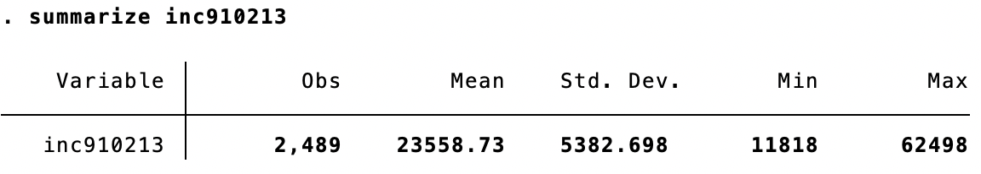
Summary Statistics
1
8
9
10
11
12
13
14
15
16
17
18
19
20
21
22
23
24
25
26
2
3
4
5
6
7
summarize function can be used to see a more detailed information of the imported data:
Observations: number of observations in the variable
Mean: Mean (Average) Value of the variable
Standard Deviation
Min
Max

Slide 12
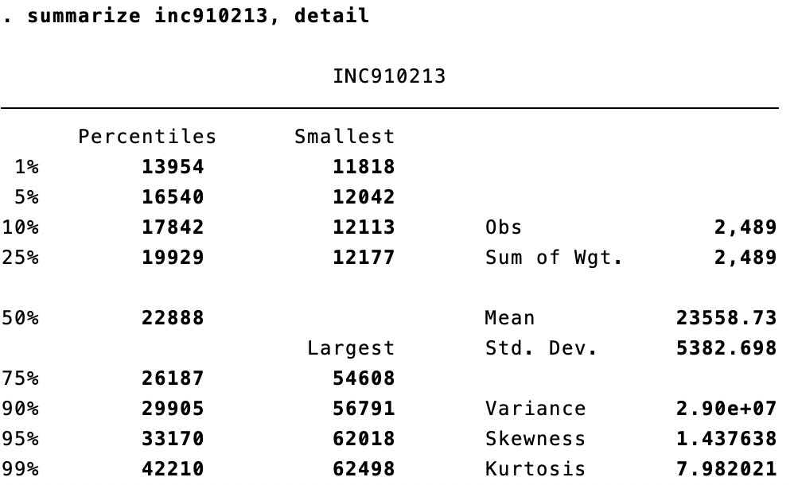
Summary Statistics
1
8
9
10
11
12
13
14
15
16
17
18
19
20
21
22
23
24
25
26
2
3
4
5
6
7
Including detail option in summarize allows users to check more specific statistics:
Percentiles: a value of the variable at a given percentile (50th Percentile = Median)
Smallest/Largest: 4 lowest/highest values
Skewness: degree of distortion in our distribution (from normal) and direction
Positive: skewed to the right
Negative: skewed to the left
Zero: Normal
Kurtosis: how “fat” the tails are in the distribution, which shows whether there are extreme outliers in the data
High deviation from 3 indicates that there is high kurtosis

Slide 13
Summary Statistics
1
8
9
10
11
12
13
14
15
16
17
18
19
20
21
22
23
24
25
26
2
3
4
5
6
7

Slide 14
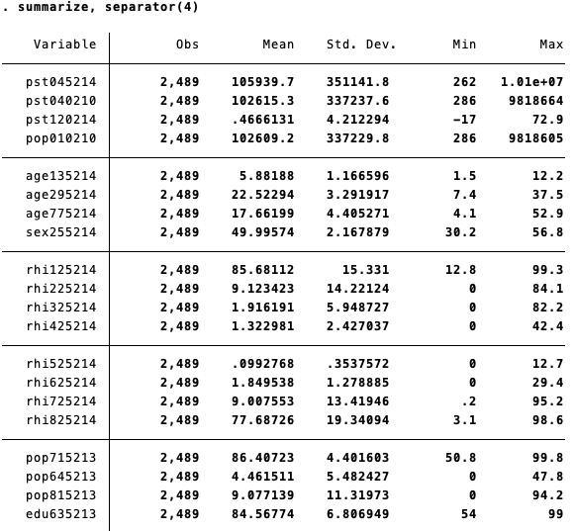
Summary Statistics
1
8
9
10
11
12
13
14
15
16
17
18
19
20
21
22
23
24
25
26
2
3
4
5
6
7
Summarize function can be used to see more detailed information about each variable. This can be done with all at once or on an individual basis
For a summary statistics output for all variables, following values are produced for each variable:
Observations
Mean
Standard Deviation
Min
Max
What can we know about winner16 variable?

Slide 15
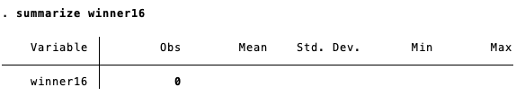
Summary Statistics
1
8
9
10
11
12
13
14
15
16
17
18
19
20
21
22
23
24
25
26
2
3
4
5
6
7
Summarize function can be used to see more detailed information about each variable. This can be done with all at once or on an individual basis
Why does winner16 have 0 observation?
As we mentioned before, it is stored as a string type, which needs to be recoded
Let’s try codebook function to check what string inputs are recorded in the variable

Slide 16
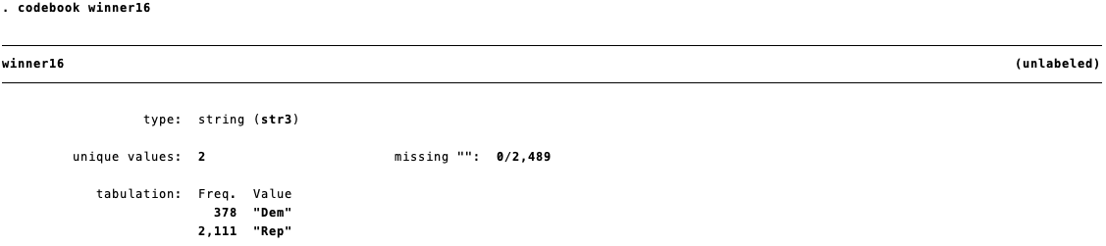
Summary Statistics
1
8
9
10
11
12
13
14
15
16
17
18
19
20
21
22
23
24
25
26
2
3
4
5
6
7
We can see that there are 378 occurrences of “Dem” and 2,111 occurrences of “Rep”
As we can see from a boxed corner, our binary variable is not labeled. And this can be problematic when we try to examine or interpret the statistical inference of the unlabeled variable.
For example, let’s say we want to run a t-test to see the statistical significance of differences between the two groups “Dem” and “Rep”
In order to run the t-test, we first must label the variables

Slide 17
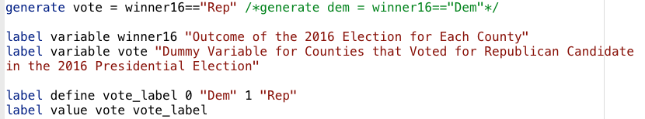
Categorical Data – Processing
1
8
9
10
11
12
13
14
15
16
17
18
19
20
21
22
23
24
25
26
2
3
4
5
6
7
Labeling is useful in analyzing variables from different observations based on their string values
Categorical Variables
Binary, Nominal, Ordinal
Can be used for classifying different categories, predicting categorical events, or explaining differences among categorical values
Numerical Variables
Continuous (infinite interval) or Discrete (finite)
Take on any value within a finite or infinite interval
Can be used for finding relationships and identifying characteristics
1
Creates vote variable with 1 = “Rep” (all else are 0)
2
Set winner16 and vote variables with descriptions
3
Redefine vote variable’s numerical value with vote_label’s string values (User Perspective)
Notes:
Binary vs Categorical → statistics, not stata, give more examples
Binary, Categorical → Color
Numerical → “Take on” any value within a finite or infinite interval”

Slide 18
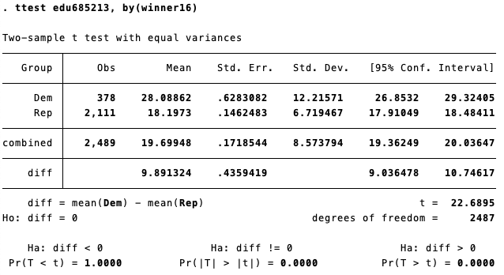
Summary Statistics (cont.)
1
8
9
10
11
12
13
14
15
16
17
18
19
20
21
22
23
24
25
26
2
3
4
5
6
7
This is t-test of % of county residents with bachelor’s degree (edu685213) on two string groups
Shows t-test result on difference between the two groups with summary statistics of each group and a complete dataset
Running t-test without specifying by condition produces the test on whether the variable is statistically significantly different from 0
Results
We find the difference statistically significant almost at 100% confidence level
We also find that the counties that elected a democratic candidate have higher proportion of college educated residents

Slide 19
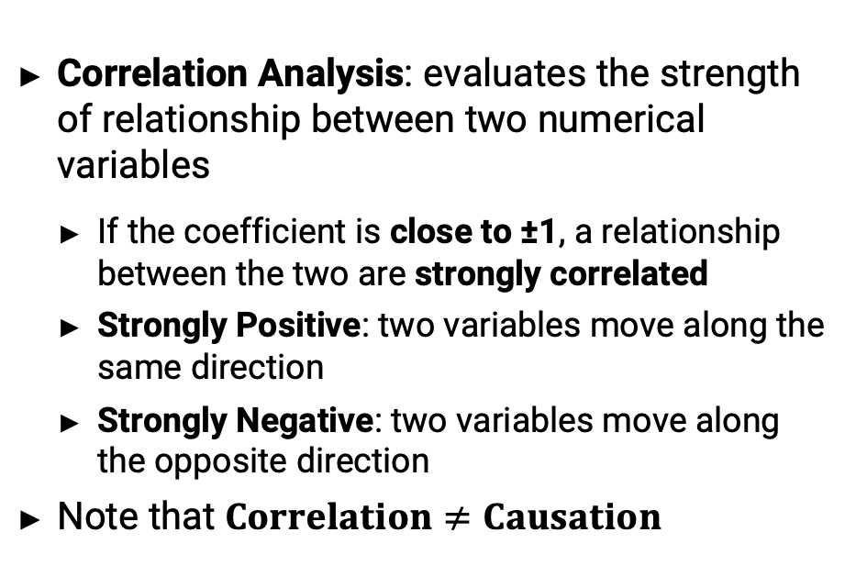
Regression – Background
1
8
9
10
11
12
13
14
15
16
17
18
19
20
21
22
23
24
25
26
2
3
4
5
6
7
Before jumping into analyzing winner16, let’s take a look at how population size impacts the number of firms in counties
Correlation Analysis: evaluates the strength of relationship between two numerical variables
If the coefficient is close to ±1, a relationship between the two are strongly correlated
Strongly Positive: two variables move along the same direction
Strongly Negative: two variables move along the opposite direction
Note that $Correlation≠Causation$

Slide 20
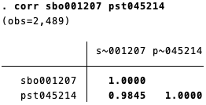
Regression – Background
1
8
9
10
11
12
13
14
15
16
17
18
19
20
21
22
23
24
25
26
2
3
4
5
6
7
Before jumping into analyzing winner16, let’s take a look at how population size impacts the number of firms in counties
Correlation Analysis: evaluates the strength of relationship between two numerical variables
If the coefficient is close to ±1, a relationship between the two are strongly correlated
Strongly Positive: two variables move along the same direction
Strongly Negative: two variables move along the opposite direction
If the two variables have corr. coefficient of 0.9845, what would the regression look like?

Slide 21
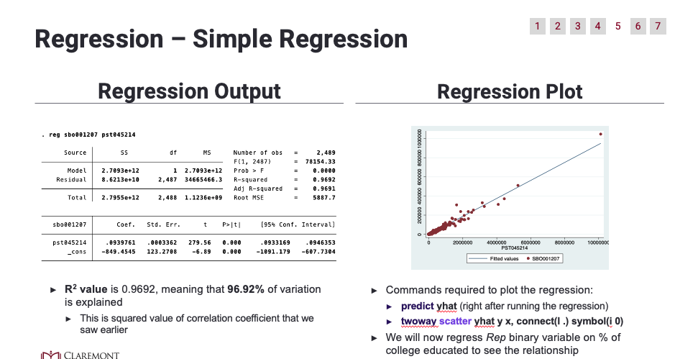

Slide 22
Hands-on Exercise
1
8
9
10
11
12
13
14
15
16
17
18
19
20
21
22
23
24
25
26
2
3
4
5
6
7
Using the sqf-2019.xlsx (NYCLU’s 2019 NYC Stop-and-Frisk Dataset), generate the following output:
Plot the distribution of age variable with a normal distribution, with 25 bins (bars). How does the distribution look like compared to the normal distribution?
Run summary statistics for age, weight and height variables. What can you imply about the variables?
Graph a bar chart to plot mean age across 5 borrows of New York City. Note that a default value for a bar chart is mean.

Slide 23
Summary / Q&A
Key Takeaways:
User Interface (Do-File)
Data Import and Exploration
Summary Statistics
Regression Analysis
Tips:
Stata/R Useful Packages: https://geocenter.github.io/StataTraining/portfolio/06_resource/
Internet Guide to Stata: http://wlm.userweb.mwn.de/Stata/
UCLA IDRE Guide: https://stats.idre.ucla.edu/stata/
Princeton DSS: https://www.princeton.edu/~otorres/Stata/StataTutorial.pdf
Contact: theqcl@cmc.edu (with a title: “Re: QCL Stata Workshop”)
Feel free to contact me (skim21@students.cmc.edu) if you have any questions on PowerPoint and Stata materials

